Slide 1


Slide 2

14
MONETARY POLICY
Notes:
Notes and teaching tips: 7, 36, 46, 47, 54, 61 and 64.
To view a full-screen figure during a class, click the expand button.
To return to the previous slide, click the shrink button.
To advance to the next slide, click anywhere on the full screen figure.
Applying the principles of economics to interpret and understand the news is a major goal of the principles course. You can encourage your students in this activity by using the two features: Economics in the News and Economics in Action.
(1) Before each class, scan the news and select two or three headlines that are relevant to your session today. There is always something that works. Read the headline and ask for comments, interpretation, discussion. Pose questions arising from it that motivate today’s class. At the end of the class, return to the questions and answer them with the tools you’ve been explaining.
(2) Once or twice a semester, set an assignment, for credit, with the following instructions:
(a) Find a news article about an economic topic that you find interesting.
(b) Make a short bullet-list summary of the article.
(c) Write and illustrate with appropriate graphs an economic analysis of the key points in the article.
Use the Economics in the News features in your textbook as models.

Slide 3
After studying this chapter, you will be able to:
Describe Canada’s monetary policy objective and the framework for setting and achieving it
Explain how the Bank of Canada makes its interest rate decision and achieves its interest rate target
Explain the transmission channels through which the Bank of Canada influences real GDP, jobs, and inflation
Explain how monetary policy and macroprudential regulation seek to prevent financial crisis
Copyright © 2019 Pearson Canada Inc.

Slide 4
Monetary Policy Objectives and Framework
A nation’s monetary policy objectives and the framework for setting and achieving that objective stems from the relationship between the central bank and the government.

Slide 5
Monetary Policy Objective and Framework
Monetary Policy Objectives
The objective of monetary policy is ultimately political.
It stems from the mandate to the Bank of Canada, which is set out in the Bank of Canada Act 1935.
Basically, the Bank’s job is to control the quantity of money and interest rates in order to avoid inflation and, …
when possible, prevent excessive swings in real GDP growth and unemployment.

Slide 6
Monetary Policy Objective and Framework
Joint Statement of the Government of Canada and the Bank of Canada
The agreement of 2019 is
The target is defined in terms of the 12-month rate of change in the total CPI.
The inflation target is the 2 percent midpoint of the 1 to 3 percent inflation-control range.
The agreement will run until December 31, 2021.
Such a monetary policy strategy is called inflation rate targeting.

Slide 7
Monetary Policy Objective and Framework
The inflation-control target uses the CPI as the measure of inflation.
So the Bank has agreed to keep the trend CPI inflation rate at a target of 2 percent a year.
But the Bank pays close attention to core inflation, which it calls its operational guide.
The Bank believes that core inflation is a better measure of the underlying inflation trend and better predicts future CPI inflation.
Notes:
Emphasize the long-run harmony and short-run tension between the goals of monetary policy.
Note that popular discussion focuses on the short run.

Slide 8
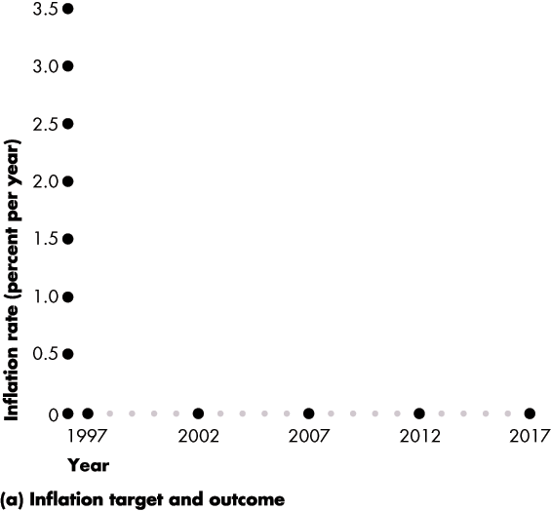
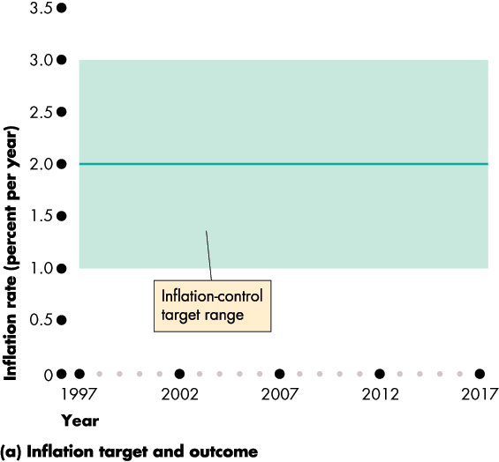
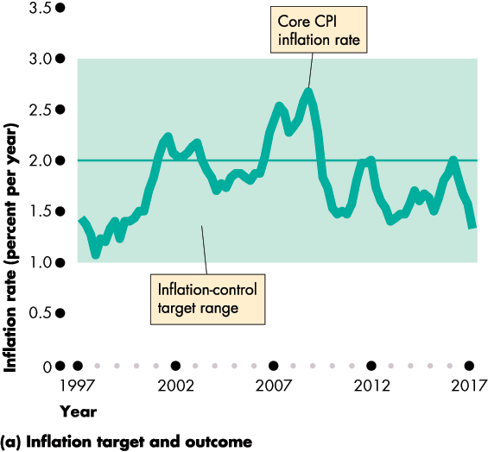

Monetary Policy Objective and Framework
Figure 14.1(a) shows the Bank’s inflation target.
The average of the three core inflation rates (CPI-common, CPI-median, and CPI-trim) has never left the target range.
The Bank has done a good job of holding inflation close to its 2 percent target.

Slide 10
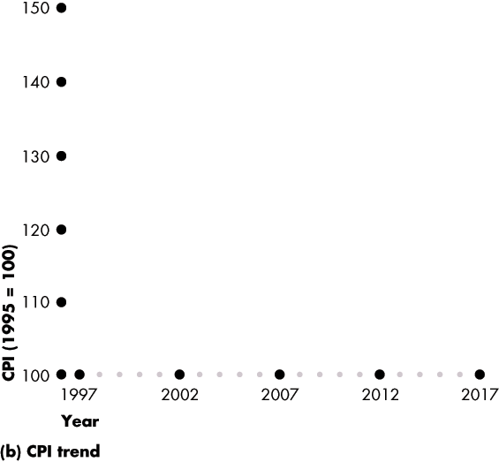
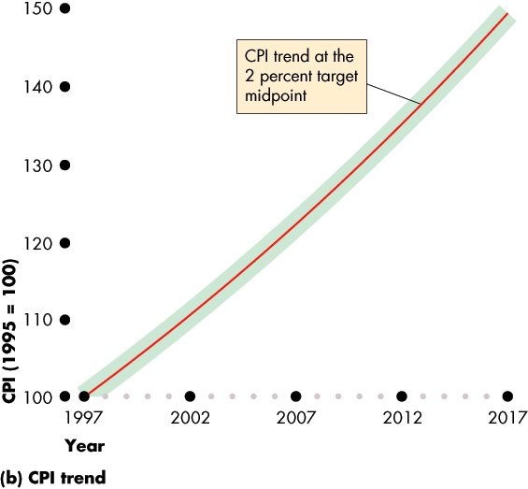
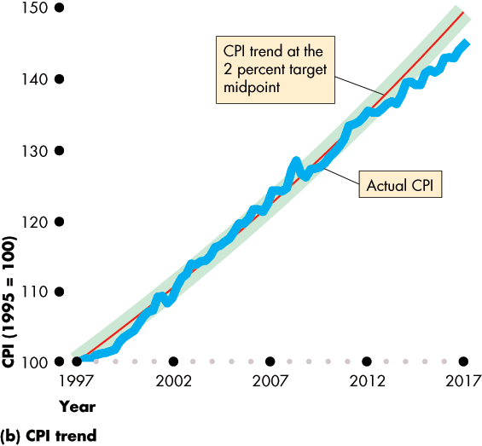
Monetary Policy Objective and Framework
Figure 14.1(b) shows the trend inflation rate of 2 percent a year, at the midpoint of the target range.
The CPI inflation rate is close to the 2 percent trend line until 2011, after which CPI inflation was below 2 percent.

Slide 12
Monetary Policy Objective and Framework
Rationale for an Inflation-Control Target
Two main benefits flow from adopting an inflation-control target:
1. Fewer surprises and mistakes on the part of savers and investors.
2. Anchors expectations about future inflation.

Slide 13
Monetary Policy Objective and Framework
Controversy About the Inflation-Control Target
Critics of inflation targeting fear that
1. By focusing on inflation, the Bank might permit the unemployment rate to rise or real GDP growth to slow.
2. The Bank might permit the value of the dollar rise on the foreign exchange market and make exports suffer.

Slide 14
Monetary Policy Objective and Framework
Supporters of inflation targeting respond:
1. Keeping inflation low and stable is the best way to achieve full employment and sustained economic growth.
2. The Bank’s record is good. The last time the Bank created a recession was at the beginning of the 1990s when it was faced with double-digit inflation.

Slide 15
Monetary Policy Objective and Framework
Responsibility for Monetary Policy
The Bank of Canada’s Governing Council is responsible for the conduct of monetary policy.
The Governor and the Minister of Finance must consult regularly.
If the Governor and the Minister disagree in a profound way, the Minister may direct the Bank in writing to follow a specified course and the Bank would be obliged to accept the directive.

Slide 16
The Conduct of Monetary Policy
How does the Bank of Canada conduct monetary policy?
What is the Bank of Canada’s monetary policy instrument?
How does the Bank of Canada make its policy decision?
How does the Bank implement its policy?

Slide 17
The Conduct of Monetary Policy
The Monetary Policy Instrument
The monetary policy instrument is a variable that the Bank of Canada can directly control or closely target.
The Bank of Canada has three possible instruments:
1. The quantity of money (the monetary base)
2. The price of Canadian money on the foreign exchange market (the exchange rate)
3. The opportunity cost of holding money (the short-term interest rate)

Slide 18
The Conduct of Monetary Policy
The Bank of Canada can set any one of these three variables, but it cannot set all three.
The values of two of them are the consequence of the value at which the third one is set.
If the Bank decreased the quantity of money, both the interest rate and the exchange rate would rise.
If the Bank raised the interest rate, the quantity of money would decrease and the exchange rate would rise.
If the Bank lowered the exchange rate, the quantity of money would increase and the interest rate would fall.

Slide 19
The Conduct of Monetary Policy
The Overnight Loans Rate
The Bank of Canada’s choice of policy instrument (the same choice made by most other major central banks) is a short-term interest rate.
Given this choice, the exchange rate and the quantity of money to find their own equilibrium values.
The Bank of Canada targets is the overnight loans rate, which is the interest rate on overnight loans that chartered banks make to each other.

Slide 20
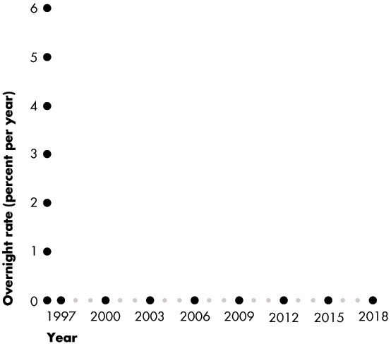
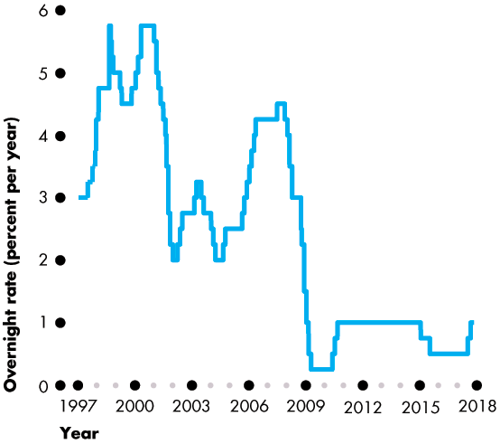
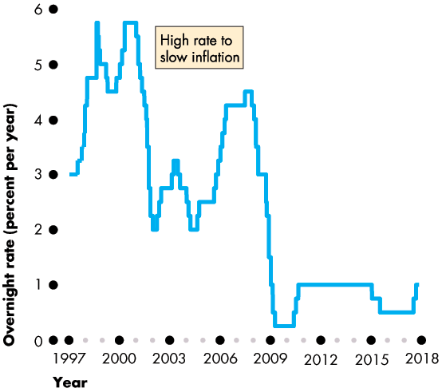
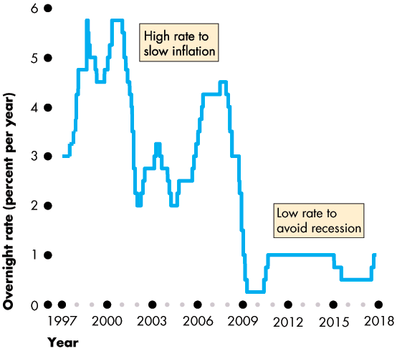
The Conduct of Monetary Policy
Figure 14.2 shows the overnight loans rate.
When the Bank wants to slow inflation, it raises the overnight loans rate.
When inflation is low and the Bank wants to avoid recession, it lowers the overnight loans rate.

Slide 22
The Conduct of Monetary Policy
Although the Bank of Canada can change the overnight loans rate by any (reasonable) amount, it normally changes the rate by only a quarter of a percentage point.
Having decided the appropriate level for the overnight loans rate, how does the Bank get the overnight loans rate to move to the target level?
The answer is by using open market operations to adjust the quantity of monetary base.

Slide 23
The Conduct of Monetary Policy
The Bank’s Interest Rate Decision
To make its interest rate decision, the Bank of Canada gathers data about the economy, the way it responds to shocks, and the way it responds to policy.
The Bank must then process the data and come to a judgement about the best level for the policy instrument.
After announcing an interest rate decision, the Bank engages in a public communication to explain the reasons for its decision.

Slide 24
The Conduct of Monetary Policy
Hitting the Overnight Loans Rate Target
Once an interest rate decision is made, the Bank of Canada achieves its target by using two tools:
Operating band
Open market operations

Slide 25
The Conduct of Monetary Policy
Operating Band
The operating band is the target overnight loans rate plus or minus 0.25 percentage points. So the operating band is 0.5 percentage points wide.
The Bank creates the operating band by setting:
1. Bank rate, the interest rate that the Bank charges big banks on loans, is set at the target overnight loans rate plus 0.25 percentage points.
2. Settlement balances rate, the interest rate the Bank pays on reserves, is set at the target overnight loans rate minus 0.25 percentage point.

Slide 26
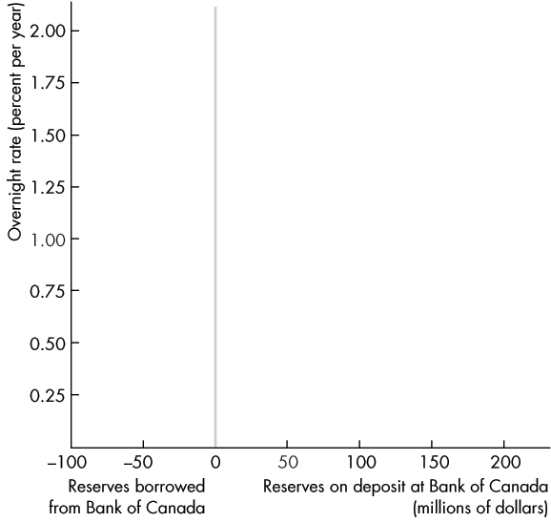
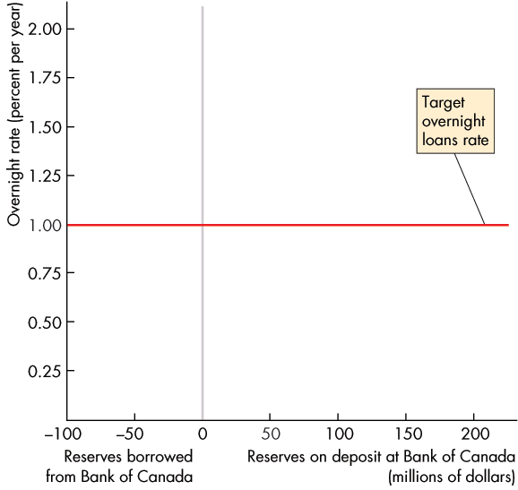
The Conduct of Monetary Policy
Figure 14.3 illustrates the market for reserves.
The x-axis measures the quantity of bank reserves held at the Bank of Canada.
The y-axis measures the overnight loans rate.
The red line shows the target for the overnight loans rate.
Notes:
.

Slide 27
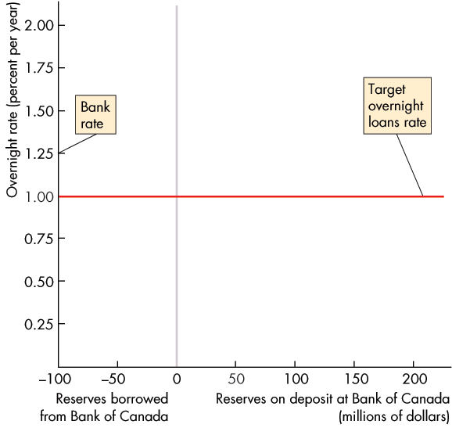
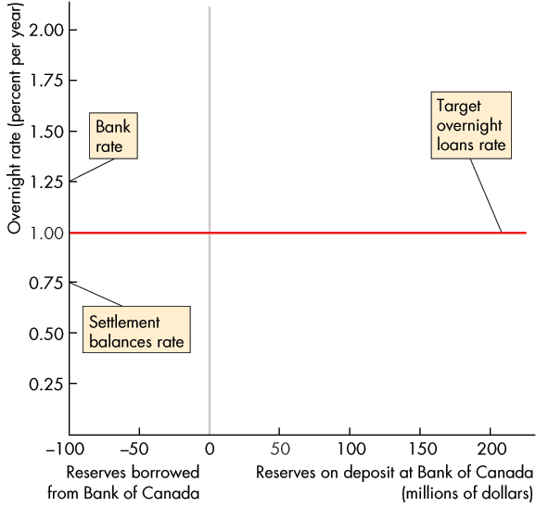
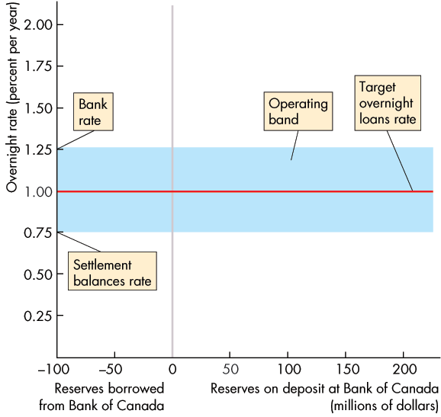
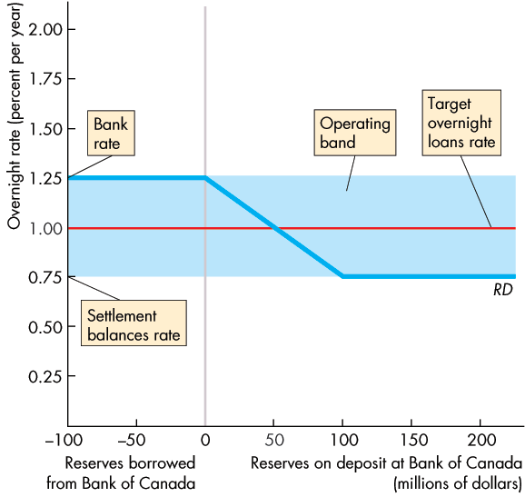
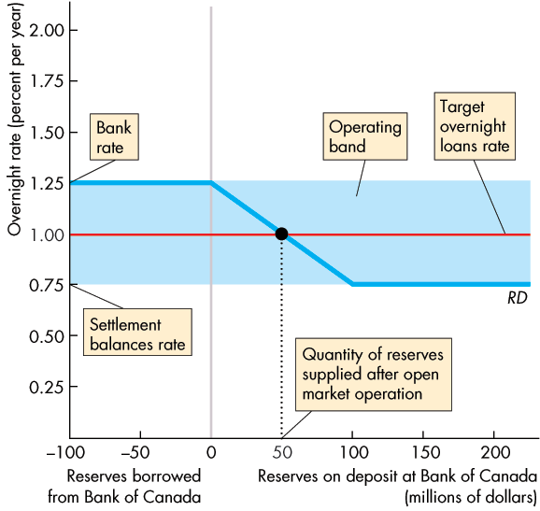

Slide 28
The Conduct of Monetary Policy
Bank rate is set at target overnight loans rate plus 0.25 percentage points.
Settlement balances rate is set at target overnight loans rate minus 0.25 percentage points.
The blue bar is the Bank’s operating band for the actual overnight loans rate.

Slide 29
The Conduct of Monetary Policy
The overnight loans rate cannot exceed bank rate because, if it did, a bank could make a profit by borrowing from the Bank of Canada and lending to another bank.
But all banks can borrow from the Bank of Canada at bank rate, so no bank is willing to pay more than bank rate to borrow reserves.

Slide 30
The Conduct of Monetary Policy
The overnight loans rate cannot fall below the settlement balances rate.
If it did, a bank could make a profit by borrowing from another bank and increasing its reserves at the Bank of Canada.
But all banks can earn the settlement balances rate, so no bank will lend at a rate below that level.

Slide 31
The Conduct of Monetary Policy
The banks’ demand for reserves is the curve RD.
If the overnight loans rate equals bank rate, banks are indifferent between borrowing reserves and lending reserves.
The demand curve is horizontal at bank rate.

Slide 32
The Conduct of Monetary Policy
If the overnight loans rate equals the settlement balances rate, banks are indifferent between holding reserves and lending reserves.
The demand curve is horizontal at the settlement balances rate.

Slide 33
The Conduct of Monetary Policy
If the overnight rate lies between bank rate and the settlement balances rate, banks are willing to borrow and lend to one another at the overnight loans rate.
But the overnight loans rate is the opportunity cost of holding reserves, so the higher the overnight loans rate, the fewer are the reserves demanded.

Slide 34
The Conduct of Monetary Policy
The Bank’s open market operations determine the actual quantity of reserves in the banking system.
Equilibrium in the market for reserves—where the quantity of reserves demanded equals the quantity supplied—determines the actual overnight loans rate.

Slide 35
The Conduct of Monetary Policy
So the Bank uses open market operations to keep the overnight loans rate on target.

Slide 36
Monetary Policy Transmission
The Bank of Canada’s goal is to keep the inflation rate as close as possible to 2 percent a year.
When the Bank uses its policy tools to move the overnight loans rate closer to its desired level, a series of events occur.
We’re now going to trace the events that follow a change in the overnight loans rate and see how those events lead to the ultimate policy goal—keeping inflation on target.
Notes:
The description of the transmission mechanism given here is very eclectic and includes all the possible channels that the literature has suggested. You might want to rebalance the emphasis toward the mechanism that you think most powerful.

Slide 37
Monetary Policy Transmission
Quick Overview
When the Bank of Canada lowers the overnight loans rate:
1.The Bank buys securities in an open market operation.
2. Other short-term interest rates and the exchange rate fall.
3. The quantity of money and the supply of loanable funds increase.
4. The long-term real interest rate falls.
5. Consumption expenditure, investment, and net exports increase.

Slide 38
Monetary Policy Transmission
6. Aggregate demand increases.
7. Real GDP growth and the inflation rate increase.
When the Bank of Canada raises the overnight loans rate, the ripple effects go in the opposite direction.
Figure 14.4 provides a schematic summary of these ripple effects, which stretch out over a period of between one and two years.

Slide 39


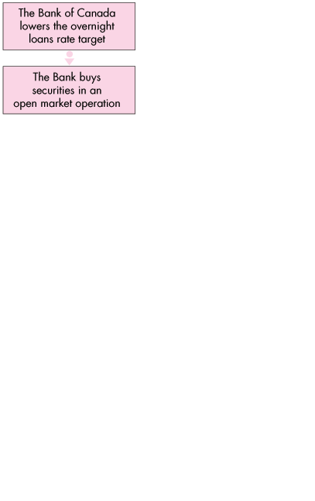
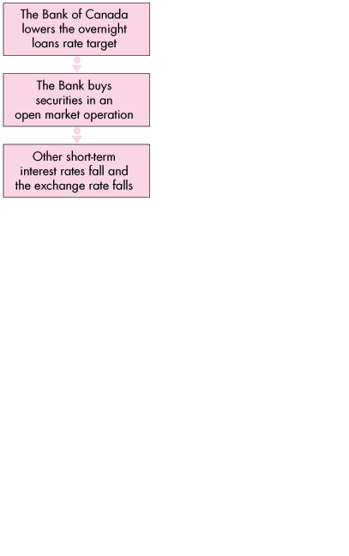
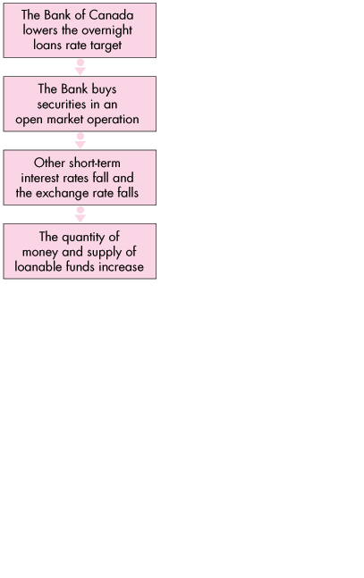
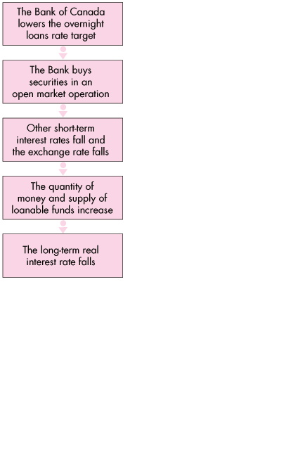
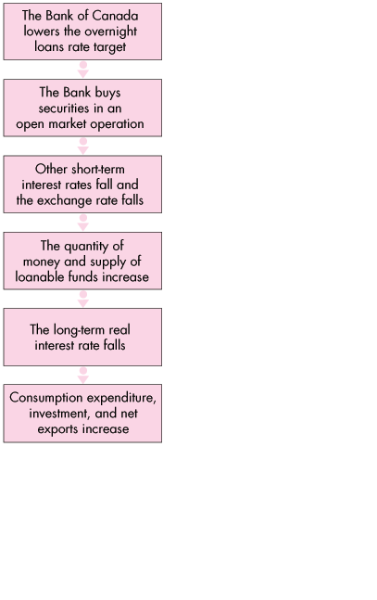
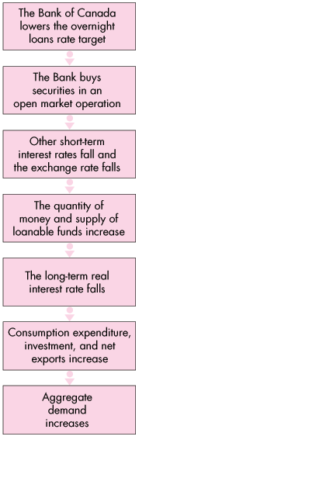
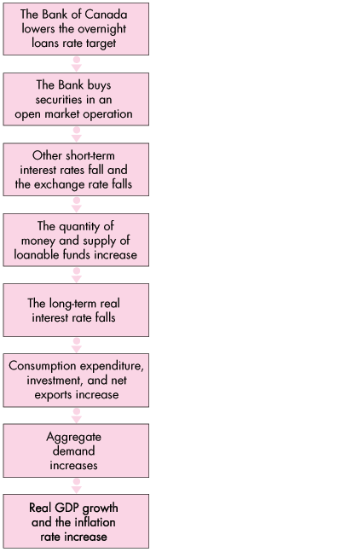
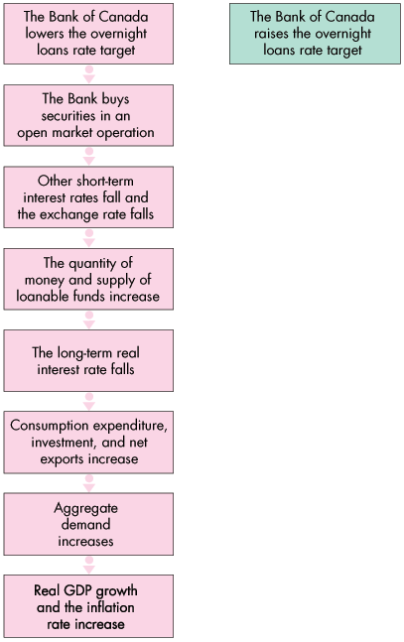
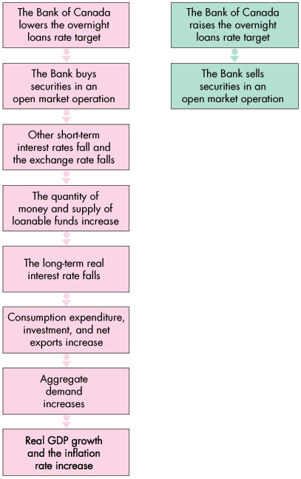
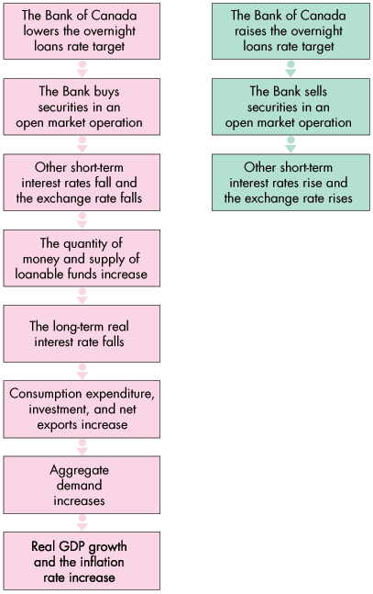
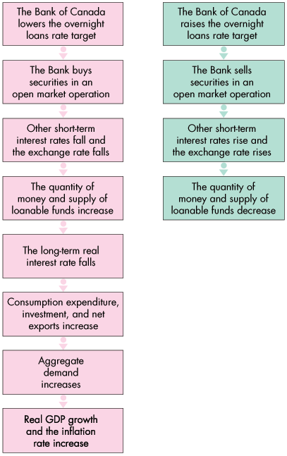
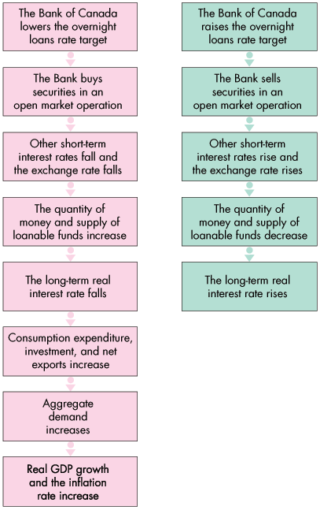
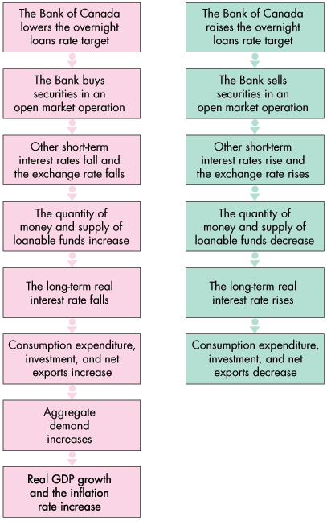
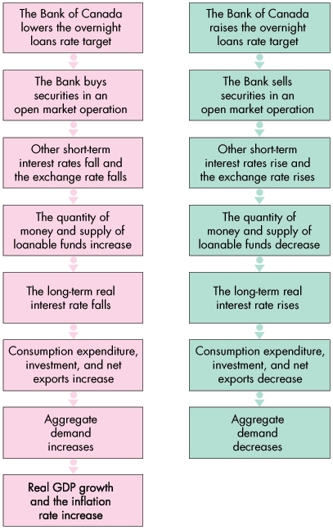
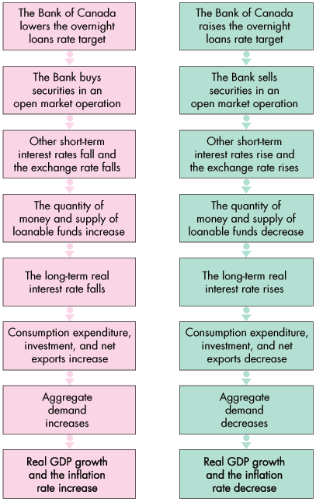
Monetary Policy Transmission

Slide 41
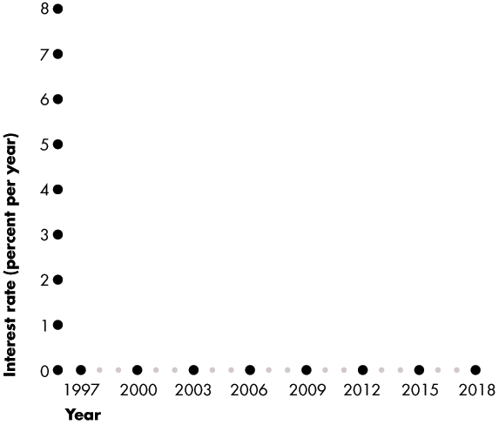
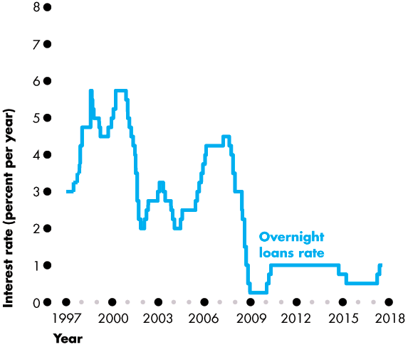
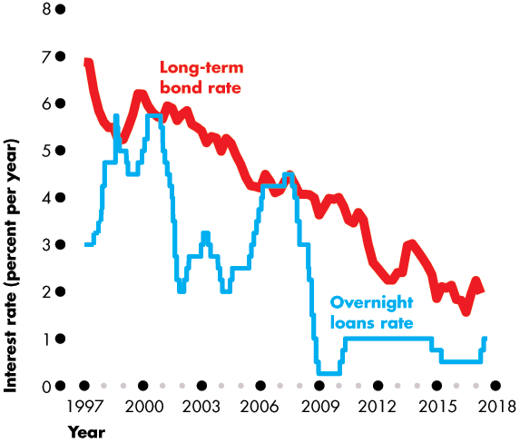
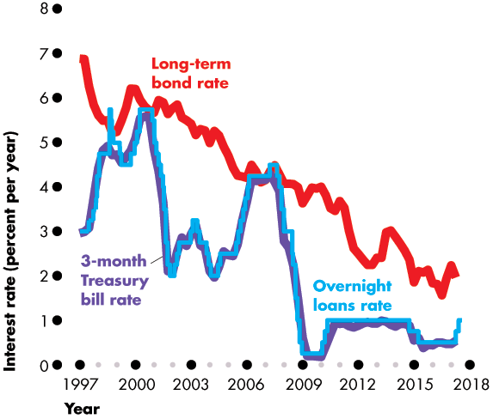
Monetary Policy Transmission
Interest Rate Changes
Figure 14.5 shows the fluctuations in three interest rates:
The overnight loans rate
The long-term bond rate
The short-term bill rate

Slide 43
Monetary Policy Transmission
Short-term rates move closely together and follow the overnight loans rate.
Long-term rates move in the same direction as the overnight loans rate but are only loosely connected to the overnight loans rate.

Slide 44
Monetary Policy Transmission
Exchange Rate Fluctuations
The exchange rate responds to changes in the interest rate in Canada relative to the interest rates in other countries—the Canadian interest rate differential.
But other factors are also at work, which make the exchange rate hard to predict.

Slide 45
Monetary Policy Transmission
Money and Bank Loans
When the Bank lowers the overnight loans rate, the quantity of money and the quantity of bank loans increase.
Consumption and investment plans change.
Long-Term Real Interest Rate
Equilibrium in the market for loanable funds determines the long-term real interest rate, which equals the nominal interest rate minus the expected inflation rate.
The long-term real interest rate influences expenditure plans.

Slide 46
Monetary Policy Transmission
Expenditure Plans
The ripple effects that follow a change in the overnight rate change three components of aggregate expenditure:
Consumption expenditure
Investment
Net exports
A change in the overnight loans rate changes in aggregate expenditure plans, which in turn changes aggregate demand, real GDP, and the price level.
So the Bank influences the inflation rate and output gap.
Notes:
Effects of Money on Real GDP and the Price Level: We bring in here the expenditure multiplier; it is important to ensure that students do not get confused between the multiplier impact of open market operations on the quantity of money, and the multiplier process that magnifies autonomous expenditure changes. Additionally, when using the AS-AD model to explain the impact of monetary policy, it is important to stress the text’s point that the model is a stationary simplification, whereas in reality output and the price level both tend to grow, so that rather than reducing real GDP and the price level, the Bank of Canada’s anti-inflation policy would slow their growth.

Slide 47
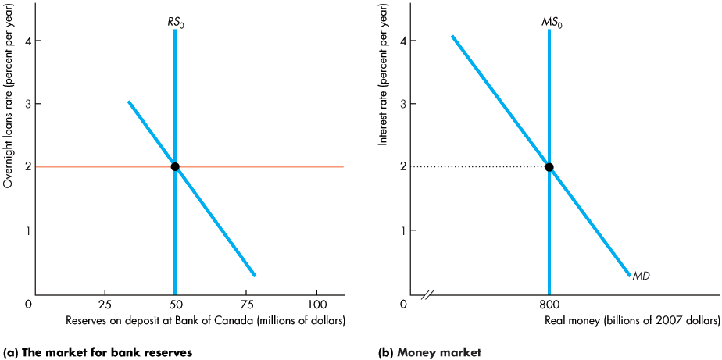
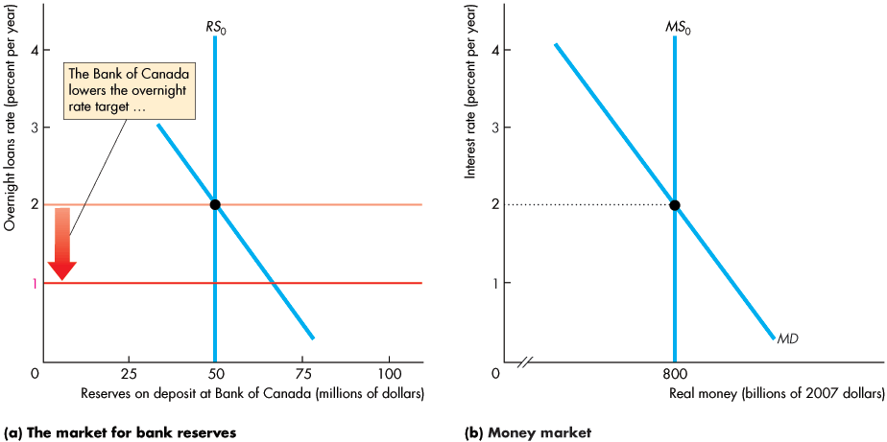
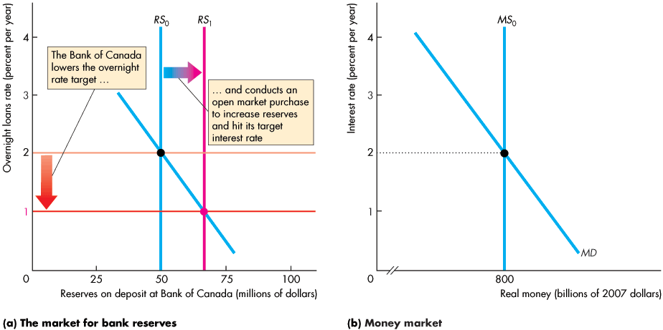
Monetary Policy Transmission
The Bank of Canada Fights Recession
If inflation is low and the output gap is negative, the Bank lowers the overnight loans rate target.
Notes:
Tying it All Together: Students often think that macroeconomics is difficult because there are so many different concepts introduced. Among others, students must learn about aggregate demand curve and the short-run and long-run aggregate supply curves; the aggregate production function; the demand for labour, the supply of labour, and the labour market; the demand for reserves, the supply of reserves, how the Bank of Canada’s policy affects the supply of reserves, and the market for reserves; the demand for money, the supply of money, the money multiplier, and the market for money; and, the demand for loanable funds, the supply of loanable funds, the market for loanable funds, and government impacts on this market.
This chapter offers a great chance for you to use the book’s very clear presentation and very straightforward presentation of monetary policy transmission to help the student see how all the parts interact. Use the book’s “four part diagrams” to show the students how everything they learned ties together to give a complete and coherent view of the otherwise exceedingly complex macroeconomy. Don’t hesitate to refer back to earlier chapters to remind the students what they learned in those chapters and how that is now being used to explain how our economy functions.

Slide 48
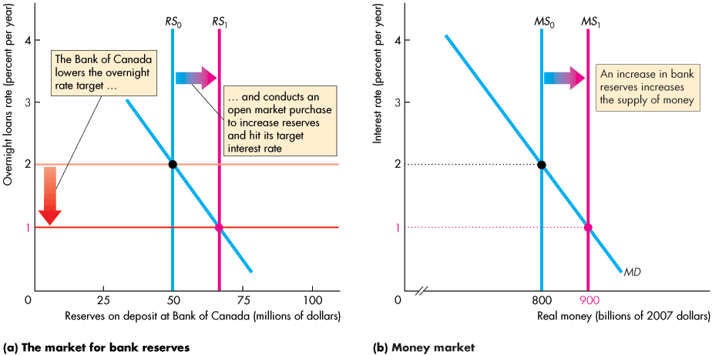
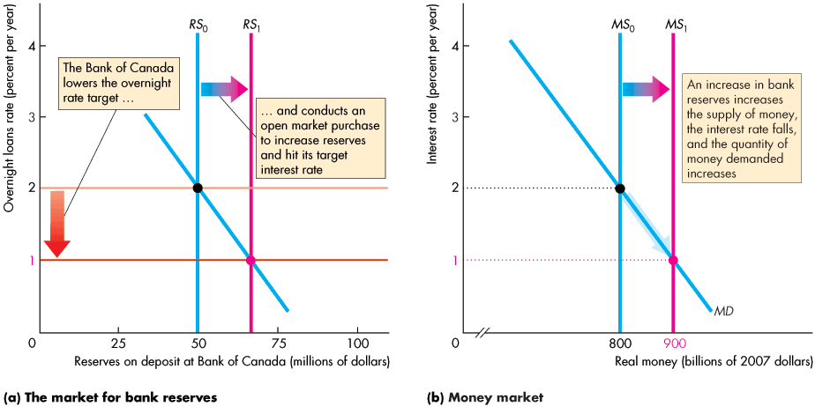

Slide 49
Monetary Policy Transmission
An increase in the monetary base increases the supply of money.
The short-term interest rate falls.

Slide 50
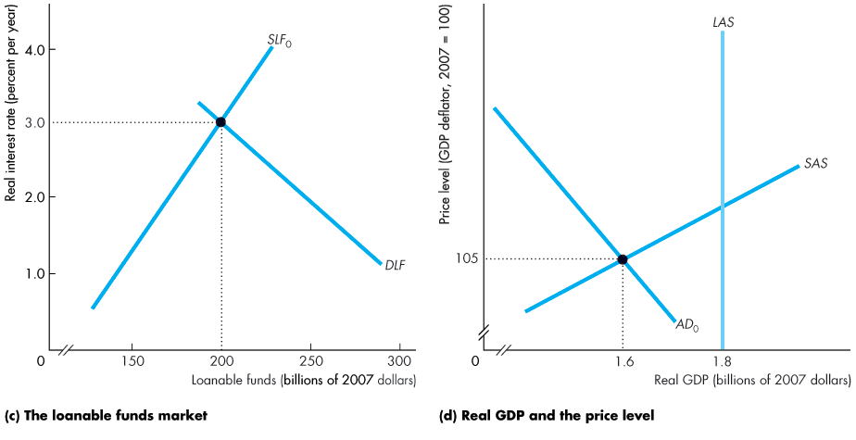
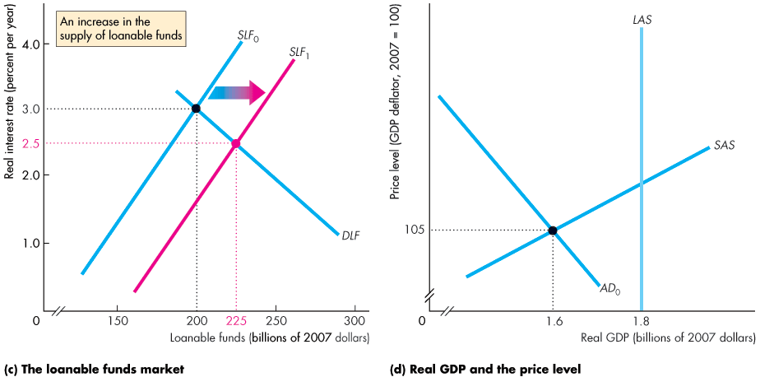
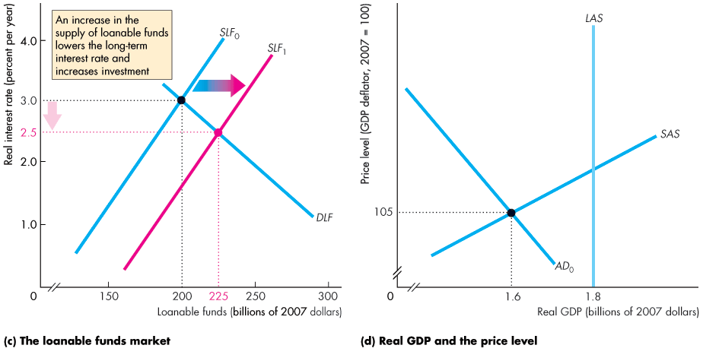

Monetary Policy Transmission
The increase in the supply of money increases the supply of loanable funds.
The long-term real interest rate falls. Investment increases.

Slide 51
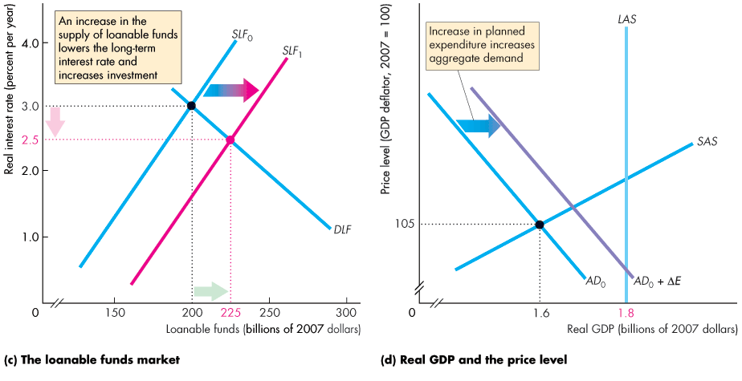
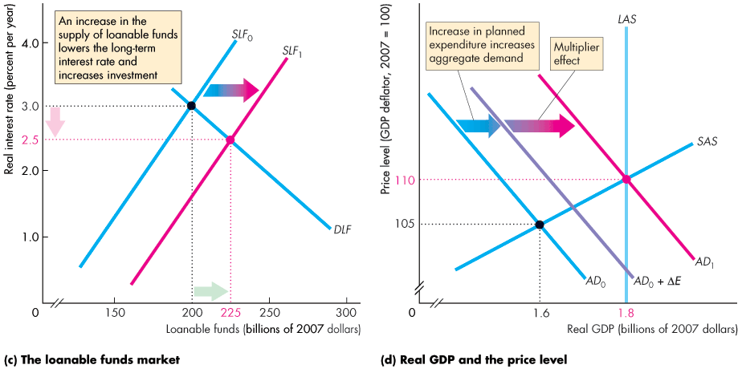

Slide 52
Monetary Policy Transmission
The fall in the real interest rate increases aggregate planned expenditure.
The multiplier increases aggregate demand.

Slide 53
Monetary Policy Transmission
Real GDP increases and closes the recessionary gap.

Slide 54
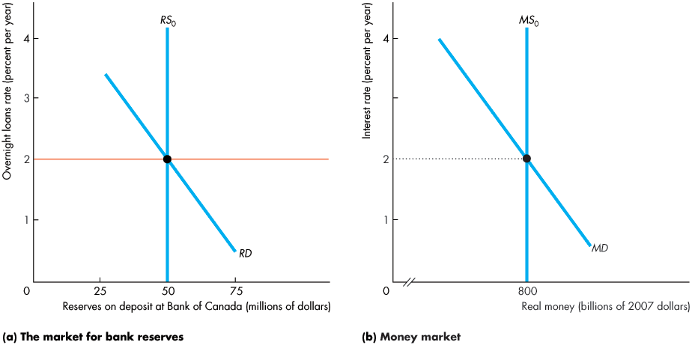
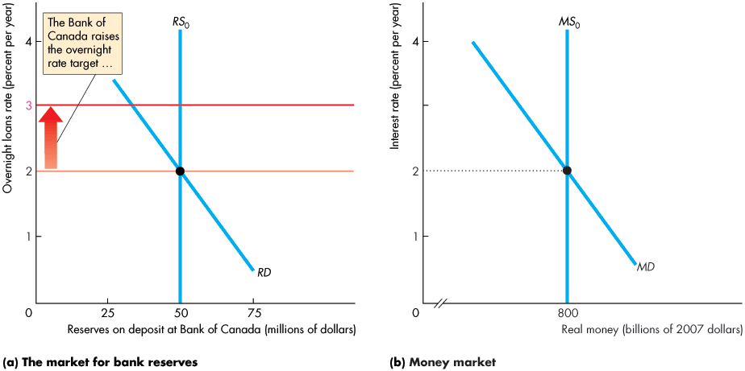
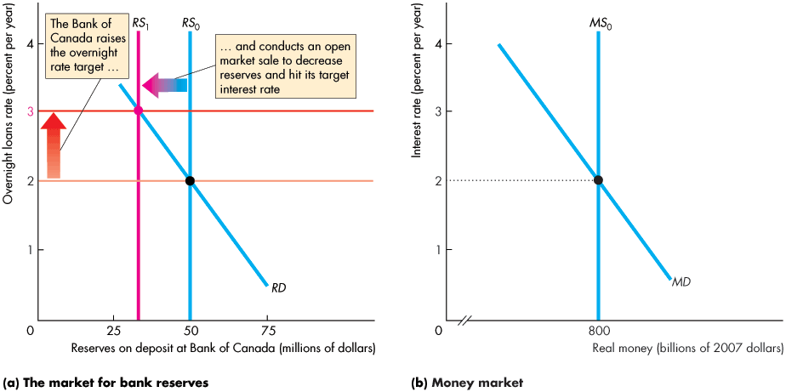
Monetary Policy Transmission
The Bank of Canada Fights Inflation
If inflation is too high and the output gap is positive, the Bank of Canada raises the overnight loans rate target.
Notes:
Classroom activity
Check out Economics in in the News: The Bank of Canada Applies a Gentle Break

Slide 55
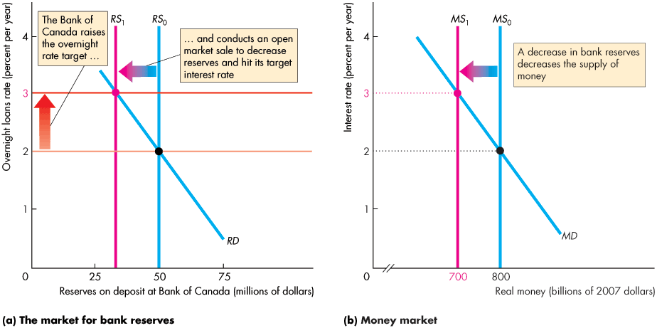


Slide 56
Monetary Policy Transmission
A decrease in the monetary base decreases the supply of money.
The short-term interest rate rises.

Slide 57




Monetary Policy Transmission
The decrease in the supply of money decreases the supply of loanable funds.
The long-term real interest rate rises. Investment decreases.

Slide 58



Slide 59
Monetary Policy Transmission
The rise in real interest rate decreases aggregate planned expenditure.
The multiplier decreases aggregate demand gap.

Slide 60
Monetary Policy Transmission
Real GDP decreases and closes the inflationary gap.

Slide 61
Monetary Policy Transmission
Loose Links and Long and Variable Lags
Long-term interest rates that influence spending plans are linked loosely to the overnight loans rate.
The response of the real long-term interest rate to a change in the nominal rate depends on how inflation expectations change.
The response of expenditure plans to changes in the real interest rate depends on many factors that make the response hard to predict.
The monetary policy transmission process is long and drawn out and doesn’t always respond in the same way.
Notes:
Classroom activity
Check out Economics in Action: A View of the Long and Variable Lag

Slide 62
Financial Crisis: Cure and Prevention
During the financial crisis and recession of 2008−2009, the Bank of Canada, U.S. Federal Reserve, and other central banks lowered their overnight rates to the floor.
What can a central bank do to stimulate the economy when it cannot lower the overnight loans rate?
The Anatomy of the Financial Crisis
The three main events that can put a bank under stress:
Widespread fall in asset prices
Large currency drain
Run on the bank

Slide 63
Financial Crisis: Cure and Prevention
During the financial crisis and recession of 2008–2009, the Fed lowered the federal funds rate to the floor.
What can the Fed do to stimulate the economy when it cannot lower the federal funds rate?
The Key Elements of the Crisis
The three main events that put banks under stress were:
Widespread fall in asset prices
A significant currency drain
A run on the bank

Slide 64
Financial Crisis: Cure and Prevention
During the financial crisis of 2007–2008 and the recession that followed, the Fed took extraordinary actions to limit the damage and restore stability while Congress took actions aimed at making the financial system more robust.
The Anatomy of the Financial Crisis
A financial crisis arises when many financial firms fail to pay their debts. Three events can put a bank under stress:
Widespread fall in asset prices
Large currency drain
Run on the bank

Slide 65
Financial Crisis: Cure and Prevention
Widespread fall in asset prices means banks suffer a capital loss.
If the fall in asset price is large, the bank’s equity might fall to zero, in which case the bank is insolvent.
The bank fails.
Large currency drain means that depositors withdraw funds and the bank loses reserves.
The bank has a liquidity crisis and is short of cash reserves.
Run on the bank occurs when depositors lose confidence and make massive withdrawals. The bank’s equity shrinks.

Slide 66
Financial Crisis: Cure and Prevention
The U.S. Fed’s Policy Actions
The Fed’s policy actions dribbled out for more than a year.
The Fed conducted massive open market operations to keep the banks supplied with reserves.
Congress Crisis Policy Actions
Extended deposit insurance
Authorized the Treasury to buy “troubled” assets.
These actions provided U.S. banks with more reserves, more secure depositors, and safe liquid assets in place of troubled assets.

Slide 67
Financial Crisis: Cure and Prevention
Macroprudential Regulation
Macroprudential regulation is financial regulation to lower the risk that the financial system will crash.
The global financial crisis of 2007–2008 brought this type of regulation to centre stage.
Macro Versus Micro Microprudential regulation seeks to lower the risk of failure of individual financial institutions.
Macroprudential regulation focuses on the interconnections among individual financial institutions and markets and their shared exposure to common shocks.

Slide 68
Financial Crisis: Cure and Prevention
The Tools
The main macroprudential regulation tools are rules about the balance sheets of banks and other financial institutions.
They are rules about ratios of loans to net worth or loans to cash and other liquid asset reserves that vary with respect to the macroeconomic environment.
For example, a microprudential regulation requires banks to increase their minimum ratio of net worth to loans, …
while a macroprudential regulation might make that minimum ratio increase during a recession and decrease in an expansion.

Slide 69
Financial Crisis: Cure and Prevention
The main macroprudential regulation tools are rules about the balance sheets of banks and other financial institutions.
They are rules about ratios of loans to net worth or loans to cash and other liquid asset reserves that vary with respect to the macroeconomic environment.
For example, a microprudential regulation requires banks to increase their minimum ratio of net worth to loans, …
while a macroprudential regulation might make that minimum ratio increase during a recession and decrease in an expansion.

Slide 70
Financial Crisis: Cure and Prevention
Canadian Macroprudential Regulation
The Minister of Finance is responsible for maintaining Canada’s financial stability, but the front line of Canada’s macroprudential policy is performed by:
The Bank of Canada
The Office of the Superintendent of Financial Institutions
The Canada Deposit Insurance Corporation.

Slide 71
Financial Crisis: Cure and Prevention
The Bank of Canada’s specific duties to further support to financial stability are.
Lender of last resort
Management of the payment system
Conductor of financial system stress tests
The Office of the Superintendent of Financial Institutions regulates and supervises financial institutions.
The Canada Deposit Insurance Corporation insures the deposits of banks and other depository institutions.

Slide 72
Financial Crisis: Cure and Prevention
Policy Strategies and Clarity
In the short run, monetary policy creates a tradeoff between inflation and unemployment.
But in the long run, monetary policy influences the inflation rate and has no effect on the unemployment rate.
In the long run, the unemployment rate is determined by the natural unemployment rate.
Inflation targeting is an attractive monetary policy strategy because it manages inflation expectations, which makes the best contribution to attaining full employment and sustained growth.

